Slide 1

Financial Management
Stock Fund Report
Varsha Manju Jayakumar
vm26476

Slide 2
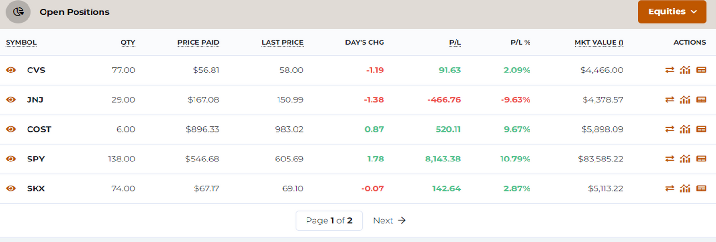
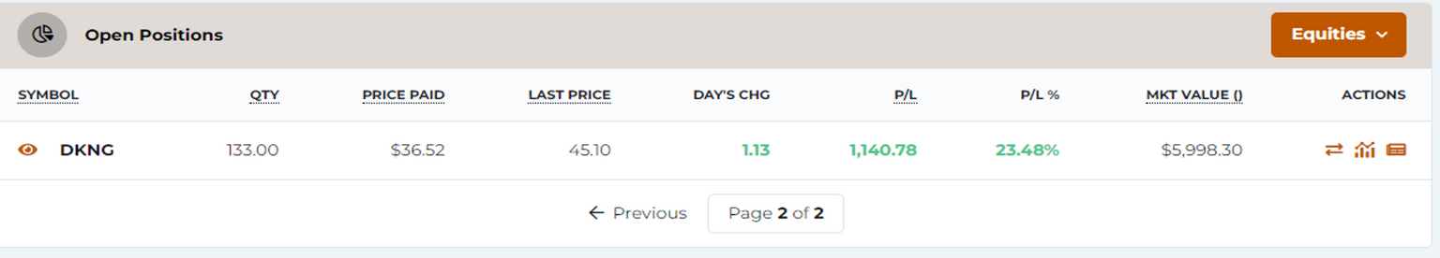
Open Positions
These represent the summary of current open positions, highlighting key metrics like quantity, price, profit/loss, and market value for each of my stock.

Slide 3
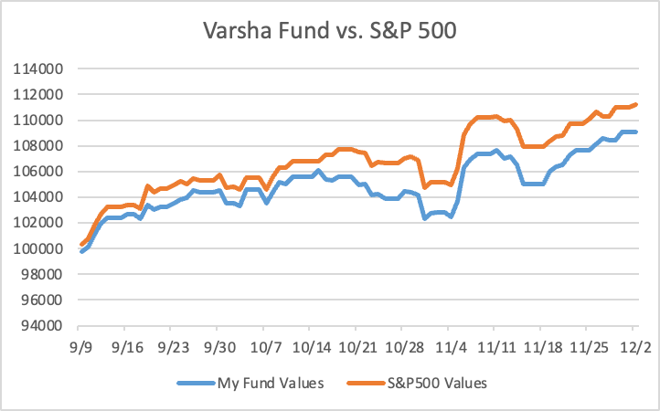
Graph of Fund Value vs. S&P 500
The chart compares the performance of my fund against the S&P 500, showing that while both trends are similar, my fund slightly underperformed the benchmark over the given period.

Slide 4
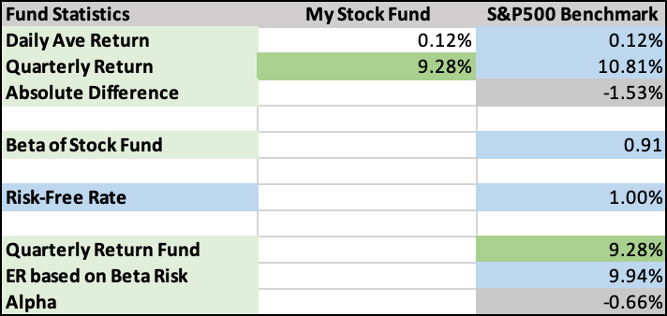
Absolute Excess return, Beta, Alpha
Here, absolute difference represents excess return of my fund over market, ignoring beta or market risk of my portfolio.
Beta represents the slope of fund returns vs. the market returns.
Alpha represents the difference between the Quarterly Return Fund and the ER based on Beta Risk.

Slide 5
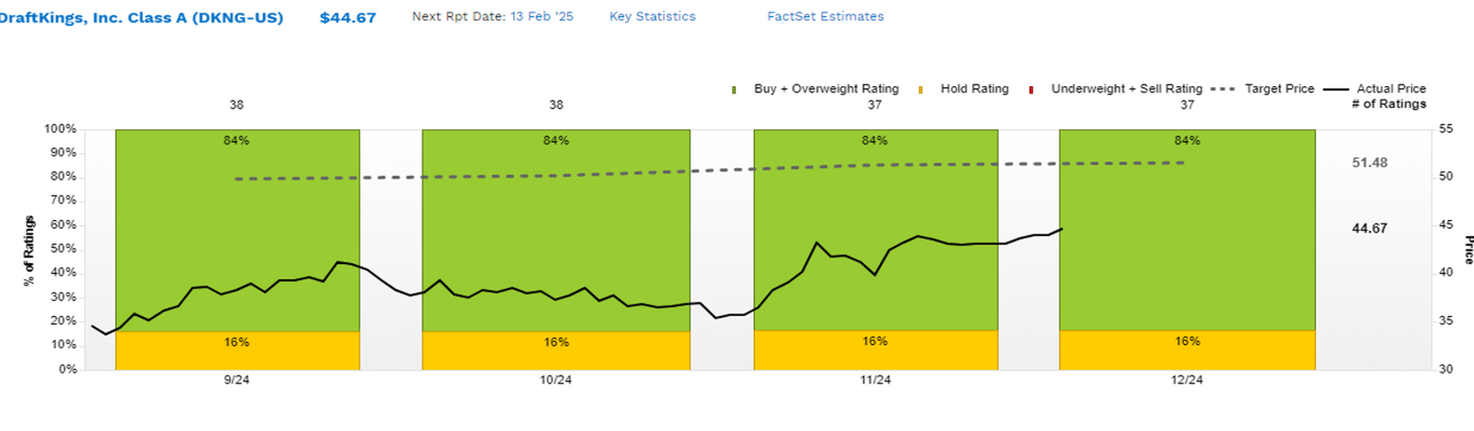
Factset Exhibit
Performance analysis of DraftKings Inc. (DKNG), highlighting 84% 'Buy' ratings with a target price of $51.48, indicating strong market confidence and potential for continued high returns.

Slide 6
Diversified Portfolio Strategy: Balancing Stability and Growth
Diversification Strategy:
By holding securities from a variety of industries, including healthcare (CVS, JNJ), retail (COST), consumer goods (SKX), exchange-traded funds (ETFs) (SPY), and entertainment/sports betting (DKNG), the fund exhibits a diversified strategy. By distributing assets throughout industries with different market dynamics, this diversification lowers risk.
Stock Selection Criteria:
The stability and market potential of the stocks were taken into consideration. For instance, SPY (an S&P 500 ETF) offers stability and wide market exposure, while COST and DKNG show promise for robust development in emerging and retail markets.
Personal Interest Drivers:
While SPY would indicate a preference for lower-risk, market-tracking investments, the inclusion of firms like DKNG indicates an interest in developing sectors like online sports betting. JNJ and COST show faith in innovative healthcare and powerful consumer brands.

Slide 7
Performance Review: Market Trends and Individual Stock Analysis
Market Overview (SPY ETF):
Following the S&P 500, the SPY ETF had a solid performance, displaying a noteworthy increase with an amazing P/L of $8,143.38 and a P/L percentage of 10.79%. This demonstrates a market-wide positive trend fueled by general economic optimism.
Stock Performance:
CVS: Despite the strength of the overall market, CVS reported a small gain of 2.09%, demonstrating consistent performance in the healthcare sector. Its defensive stock nature is consistent with this.
DKNG: With an impressive P/L of $1,140.78 and a P/L percentage of 23.48%, DKNG stood out as a company that had both growth potential and great investor trust in the sports betting sector.

Slide 8
Take-Aways
The portfolio is well-diversified, striking a balance between growth prospects like sports betting (DKNG) and stable industries like healthcare (CVS).
While DKNG did exceptionally well (+23.48%) and CVS produced consistent returns (+2.09%), the SPY ETF performed well, reflecting general market expansion.
In order to control risk and seize growth, diversification and thoughtful investment selection were essential.
To identify opportunities for rebalancing and optimizing returns, it is crucial to routinely monitor market trends and the performance of particular stocks.

Slide 9

Thank you!

